Slide 1

Smart Traffic Navigation System for Fault-Tolerant Edge Computing of Internet of Vehicle
DESIGNED FOR YOU

Slide 2
Review 1 vs Review 2 Updates
Aspect | Review 1 | Review 2
Focus | Built a fault-tolerant edge computing system for real-time traffic navigation. | Enhanced edge layer with Computational Intelligence (CI) and integrated Edge–Fog–Cloud.
Computation Models | Not implemented (only concept stage,SNN). | Implemented Reinforcement Learning (Q-learning & SARSA) for adaptive navigation.
Simulation/Testing | Not implemented (no SUMO or testing). | Used SUMO simulation + algorithm implementation with learning curves.
Fault Tolerance | Basic resilience → rerouting when sensor/link fails. | Fault-Tolerant Task Offloading (FTTO): Dynamic rerouting across Edge–Fog–Cloud.
Task Scheduling | Not defined. | Introduced Earliest Deadline First (EDF) for real-time prioritization of critical tasks.
Metrics | Not defined. | Evaluated using latency, throughput, load balance, obstacle avoidance rate, energy efficiency.
Outcomes | Conceptual design showing feasibility of edge-based navigation. | Optimized, measurable system with algorithms + metrics for safe & efficient navigation.

Slide 3
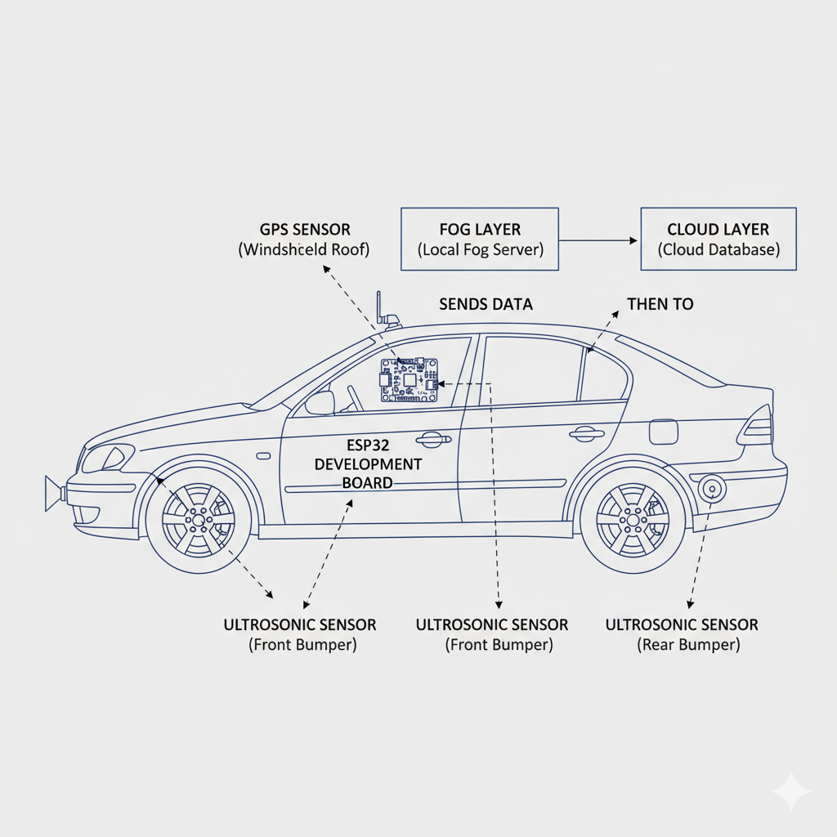
Architecture Design
Edge layer :
GPS Sensor Captures real-time location of the vehicle.
Ultrasonic Sensor Detects obstacles, distance, and surrounding objects.
Edge Node Aggregates data from sensors, performs preprocessing, and sends it for inference.
Fog layer:
Local Fog Server it Receives decision updates from edge layer.
Traffic Signal Module it Adjusts signal timing and priority according to real-time data
Cloud layer:
Cloud Database Stores aggregated data from multiple fog nodes for long-term analysis.

Slide 4
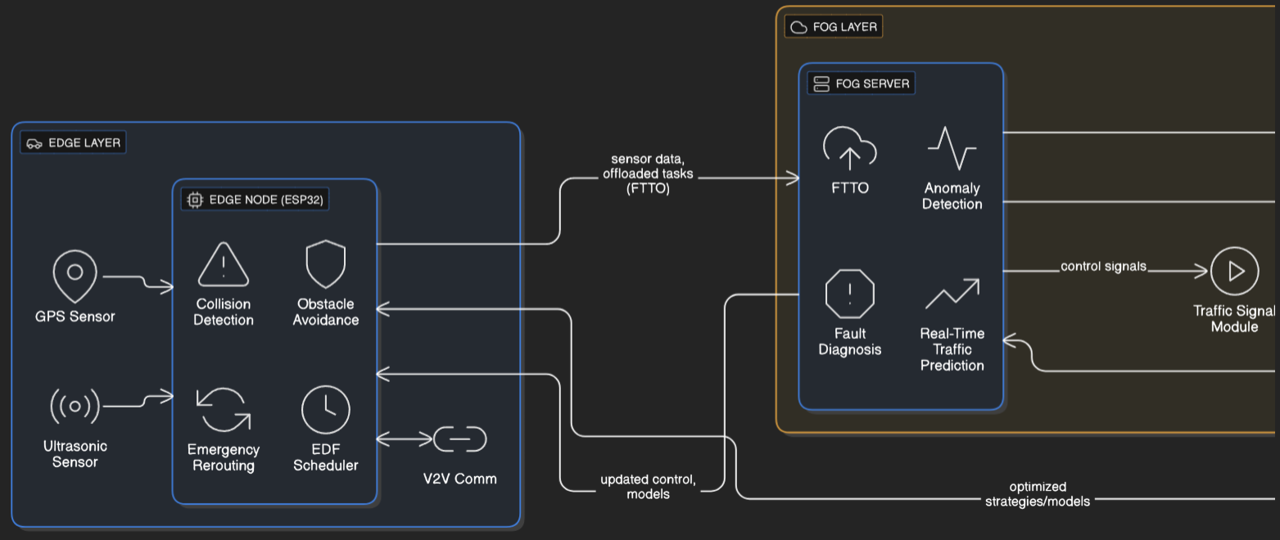
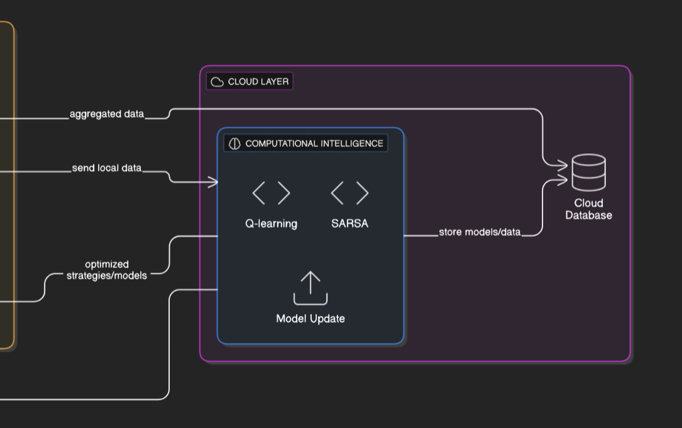
UPDATED Architecture

Slide 5
TASK SCHEDULING & ALLOCATION
EARLIEST DEADLINE FIRST (EDF) SCHEDULING ALGORITHM:
-The Earliest Deadline First (EDF) algorithm is a real-time task scheduling technique.
-It is used to decide which traffic-related task should be executed first when multiple tasks are waiting.
-Each task is assigned a deadline
-The system always executes the task with the earliest deadline first.
-Urgent and safety-critical tasks are always prioritized over less urgent tasks
-EDF ensures that life-critical vehicle actions are executed immediately, while routine navigation tasks are scheduled later.

Slide 6
FAULT-TOLERANT TASK OFFLOADING (FTTO) ALGORITHM :
-The Fault-Tolerant Task Offloading (FTTO) algorithm is used for resource allocation across Edge–Fog–Cloud after tasks have been scheduled
-It ensures that each task is executed on the most suitable computing node without interruption, even during failures.
-Critical tasks are executed locally at the Edge for lowest latency.
-If the Edge node is overloaded or fails, tasks are offloaded to Fog nodes
-if Fog resources are congested, tasks are sent to the Cloud
-FTTO ensures that safety-critical decisions even if an edge device fails

Slide 7
Problem formulation
The Problem Formulation is to design an RL agent (vehicle) that learns the best navigation policy by interacting with the traffic environment, using Q-learning and SARSA to maximize cumulative rewards for safe, efficient, and fault-tolerant driving.
Candidate Representation :Road condition (clear ,blocked)
Reward Function:
+ve reward for safe driving (maintain distance, follow signals, efficient route).
-ve reward for unsafe behavior (collision risk, congestion).
Learning Operators:
-Q-learning it updates using max future Q-value.
-SARSA it updates using the actual next action.

Slide 8
Metrics and Significance of Results
Communication Latency: Time taken for data to travel in the RL-based network.
Routing Distance: The number of hops a signal must travel.
Load Balance: How evenly signals are distributed across hardware nodes.
Maximum Throughput: The maximum decisions the system can handle per unit time.
Obstacle Avoidance Rate: How accurately the vehicle avoids static and moving obstacles.
Energy Efficiency: Memory, logic units, and power used on FPGA hardware
Significance:
-RL provides adaptive learning
-Q-learning ensures optimal routes in the long run
-SARSA ensures safe driving in uncertain or fault conditions.

Slide 9
CI MODEL
Q-Learning:
-A model-free Reinforcement Learning algorithm.
-Learns by exploring all possible state–action combinations
-Focuses on finding the optimal long-term policy, not just short-term gains.
Why Optimal:
-Quickly identifies the best traffic routes that minimize congestion.
-Independent of the current driving/exploration strategy that ensures convergence to the optimal solution.
-Balances exploration and exploitation to continuously improve route selection.
Relevance to Traffic:
-Helps vehicles or signals dynamically choose routes with least congestion.
-Adapts to sudden changes (accidents, jams, new road conditions).
-Improves overall traffic efficiency and reduces travel time for many agents.
-Suitable for large, complex city networks where multiple alternative paths

Slide 10
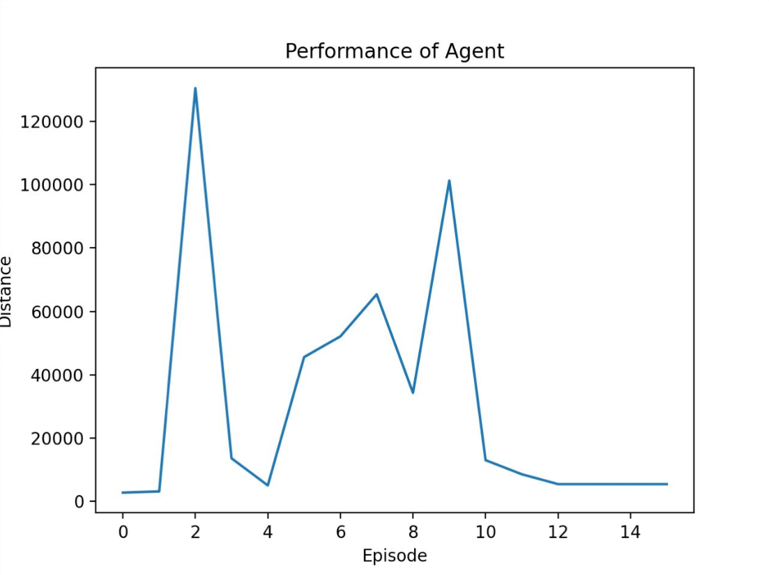
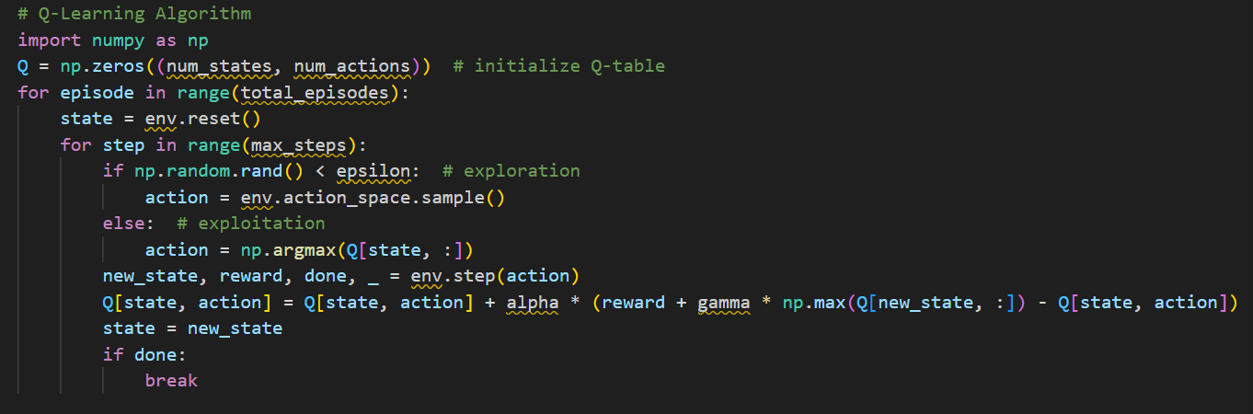
Algorithm Implementation and Learning Curve of Algorithms

Slide 11
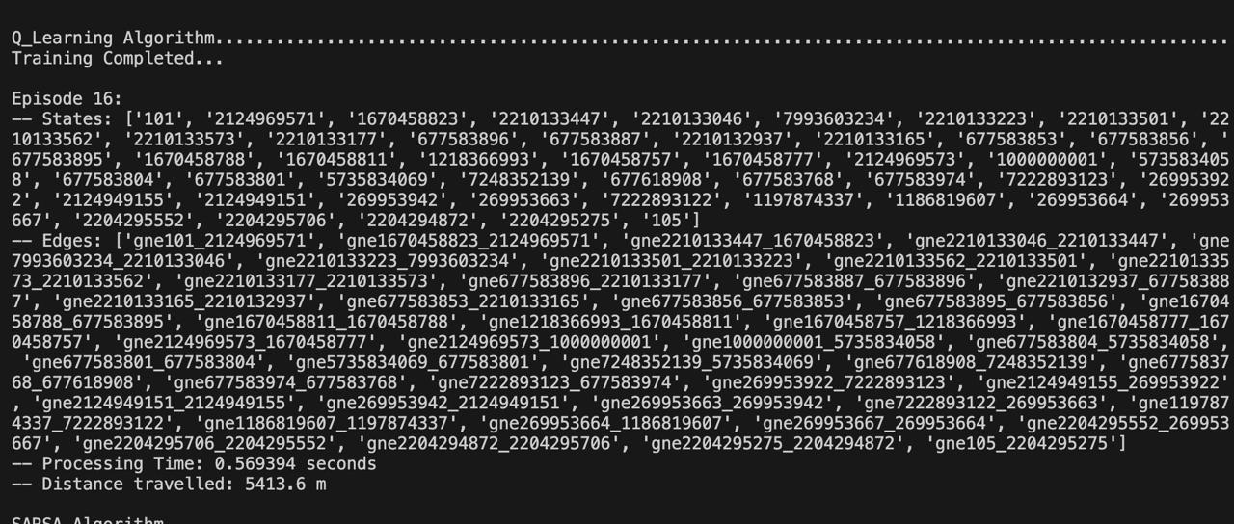
Output of Q-Learning ALGORITHM

Slide 12
SARSA
-Reinforcement Learning algorithm that updates based on the policy the agent actually follows.
-Sequence: State → Action → Reward → State → Action (SARSA).
-More conservative compared to Q-Learning, since it learns from real actions taken.
Why Optimal:
-Ensures stability in learning → avoids risky or abrupt changes in routes.
-Adapts cautiously, making it safer for real-world traffic environments.
-Works better when unexpected penalties are common.
Relevance to Traffic:
-Encourages smoother traffic flow by avoiding sudden rerouting.
-Prevents congestion from shifting abruptly from one road to another.
-Ideal for environments where safety and predictability are as important as efficiency.
-Useful in smaller or moderate-sized traffic networks with frequent uncertainties.

Slide 13
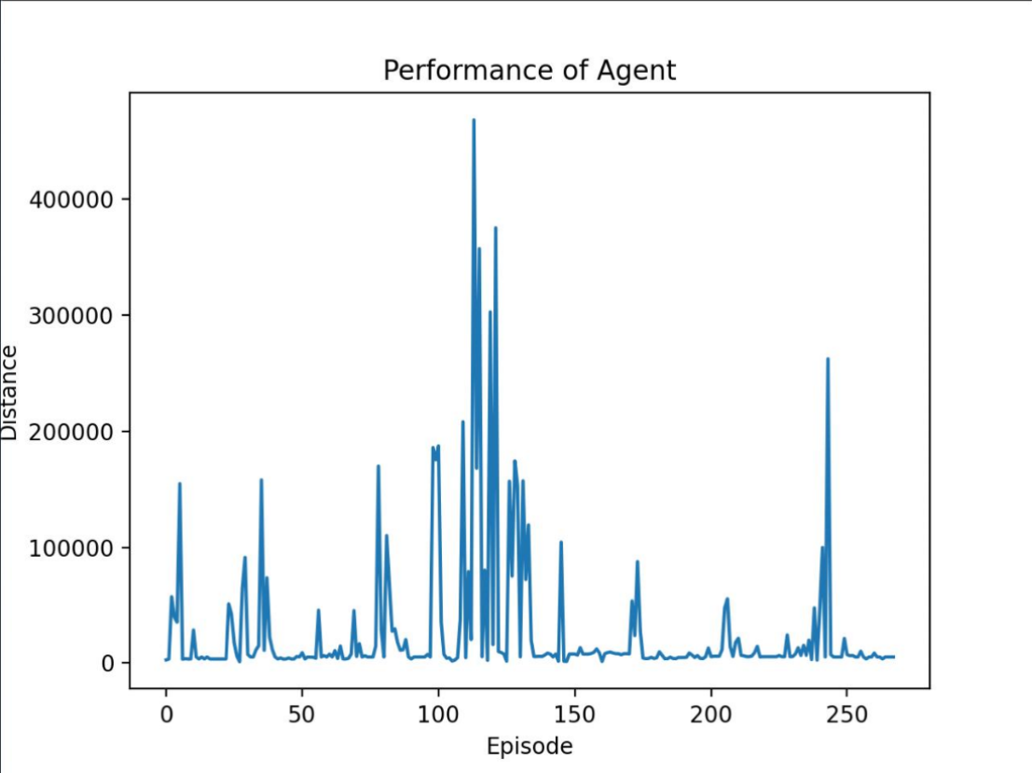
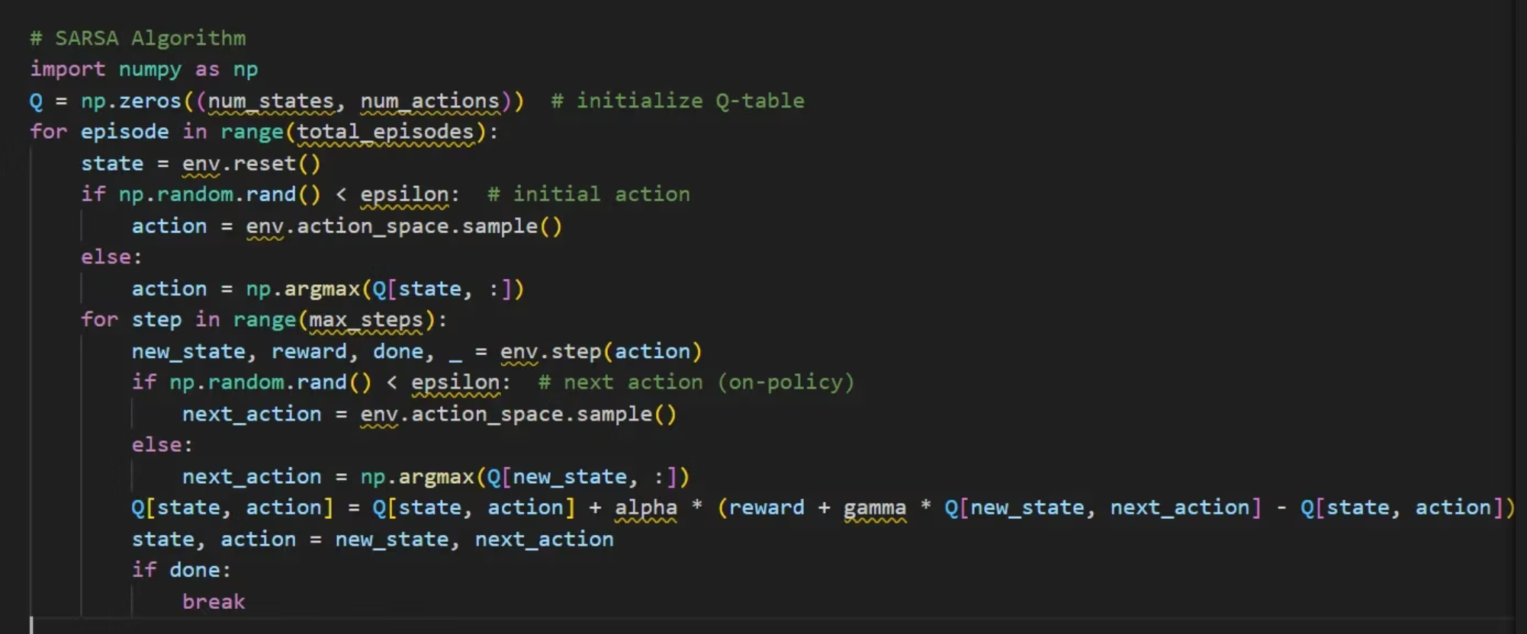
Algorithm Implementation and Learning Curve of Algorithms

Slide 14
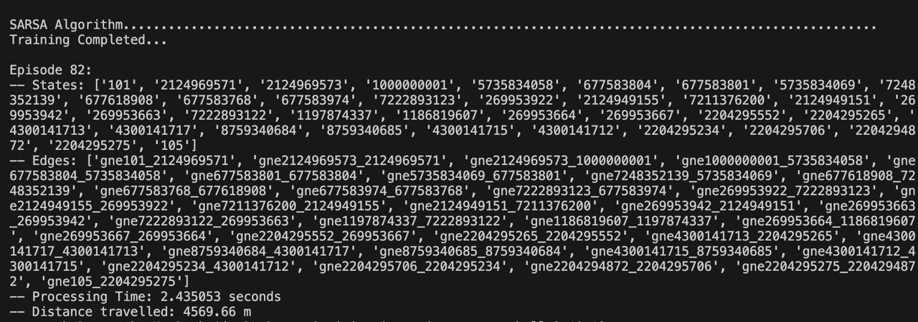
Output of SARSA ALGORITHM

Slide 15
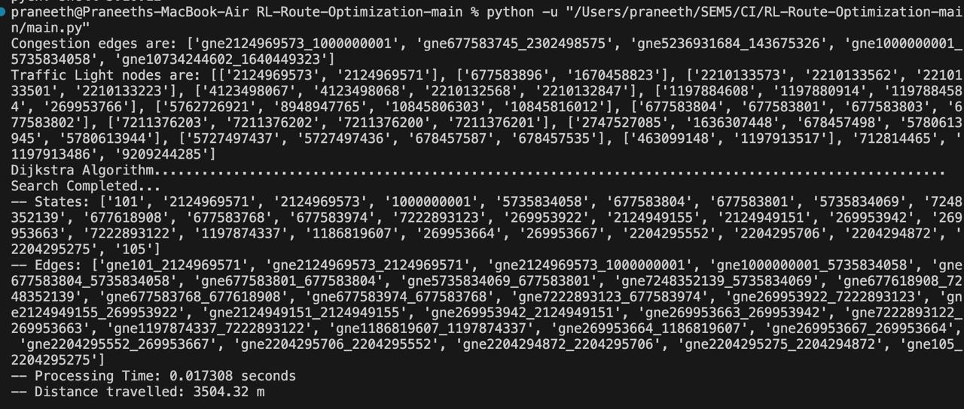

Slide 16
Q&A

